Slide 1
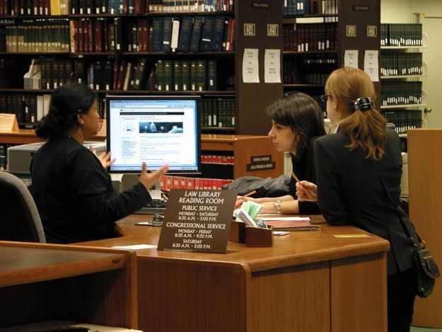
Library Management System on UNIX
Streamlining Library Operations through Command-Line Interface
Presented By:
Kashvi Agarwal(1BM23CS142) Kumud Ghimire(1BM23CS160)
K.Keerthi Reddy(1BM23CS137) Kanishka Sharma(1BM23CS138)

Slide 2
Table of Contents
Content:
Introduction – Overview of the system, its purpose, and its technology.
Key Features – Detailed explanation of the main features of the system.
System Flow and Menu Structure – How the program runs, from login to main menu options.
User Interaction – Step-by-step breakdown of how the user interacts with the system.
Results and Analysis – Key outcomes and benefits of implementing the system.
Conclusion and Future Enhancements – Summarizing the system and ideas for improvement.

Slide 3
Introduction to the System
System Overview: Brief description of Library Management System.
This system is designed to automate library processes such as managing books, borrowers, and the borrowing process.
Purpose:
The primary goal is to streamline the management of books and users in the library by using a command-line interface on a UNIX system.
Technology:
The system leverages UNIX shell scripting, Zenity (for GUI elements like dialog boxes), and file handling techniques to manage the data.
Why UNIX?:
UNIX’s flexibility, command-line capabilities, and file handling make it the ideal platform for this application.

Slide 4
Key Features of the System
Main Menu Options:
List all books – Displays all books currently in the library.
Add a book – Allows users to add new books to the library.
Borrow a book – Enables users to borrow available books.
Return a book – Lets users return borrowed books.
Remove a book – Deletes a book from the system.
List all borrowers – Displays all registered borrowers.
Create Library ID – Allows users to register a new library ID.
Remove Library ID – Deletes a library ID (for registered users).
Exit – Closes the program.

Slide 5
Zenity Integration:
Zenity dialog boxes are used throughout the system for user-friendly pop-ups and notifications.
Command-Line Interface:
The system uses simple text-based input and output for seamless interaction.

Slide 6
System Flow and Menu Structure
Program Flow:
When the program starts, users are prompted to login or register.
Login Process: Users enter their credentials to authenticate.
Registration Process: New users can create an account.
Once logged in, users are presented with the Main Menu for further actions.
After each action (e.g., borrow a book), users return to the main menu until they select Exit.
Menu Flow:
Login/Register → Main Menu → Action (Borrow, Add, Remove, etc.) → Return to Main Menu
→ Exit

Slide 7
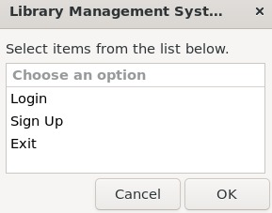
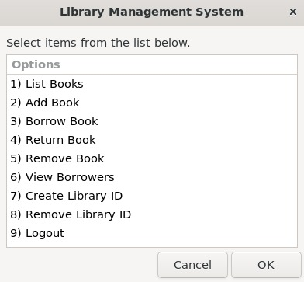

Slide 8
Login and Registration Process
Login:
Users provide their credentials (email/password) to authenticate themselves.
If credentials are valid, the user is granted access to the library system.
Registration:
New users can create an account by providing necessary information like name, email, and password.
Once registered, they can proceed to login using their credentials.
Security:
Only authenticated users can access their personalized profiles and library data.
Zenity Dialog Boxes:
Zenity is used to show login/register prompts and provide success/error feedback.

Slide 9
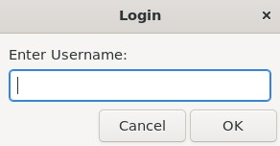
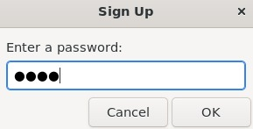

Slide 10
Main Menu Interaction
How the Main Menu Works:
After logging in, users see a list of available options (like List Books, Add Book, Borrow Book, etc.).
Each option corresponds to a specific action that the user can take in the library system.
Zenity in Action:
Zenity is used for selecting menu options and for displaying confirmation messages (e.g., successful book borrow).
If a user selects an invalid option, Zenity shows a warning dialog asking them to try again.
Continuous Interaction:
The system continuously loops through the main menu until the user chooses "Exit”.

Slide 12
User Action Example: Borrowing a Book
Example Action: Borrowing a Book
Step 1: User selects "Borrow a book" from the main menu.
Step 2: A list of available books is displayed.
Step 3: User selects a book to borrow.
Step 4: The system confirms the borrow action and updates the records.
Step 5: User is shown a success message (via Zenity dialog).
User Interaction:
The user interacts with the system via simple prompts and selections.
Zenity ensures smooth, user-friendly interactions.

Slide 13
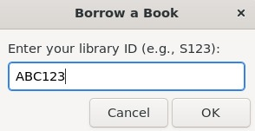
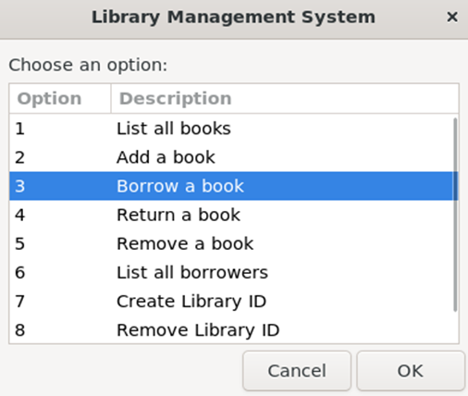
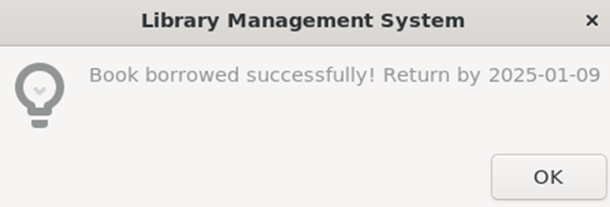

Slide 14
Error Handling and Validation
Invalid Input:
If the user selects an invalid option or enters incorrect details, the program shows an error message via Zenity.
For example, "Invalid choice, please try again!"
Handling User Mistakes:
The system ensures users can correct mistakes without crashing or causing issues.
This helps in maintaining a seamless user experience.
Continuous Loop:
The program continues asking for input until a valid option is selected.

Slide 15
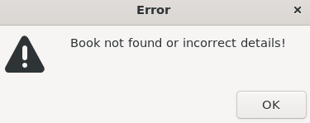
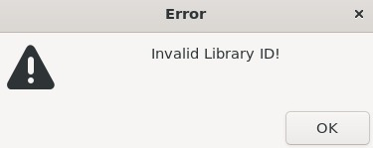

Slide 16
Result and analysis
Key Outcomes:
Efficient book management and user interaction in the library.
Reduction in manual errors and time spent managing books and users.
Easy-to-use interface thanks to Zenity dialog boxes.
System Efficiency:
The system saves time for both users and administrators by automating key tasks.
Potential Improvements:
You could later add features like advanced book search, overdue tracking, or even a database for persistent storage.

Slide 17
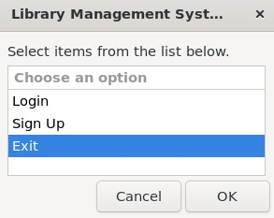

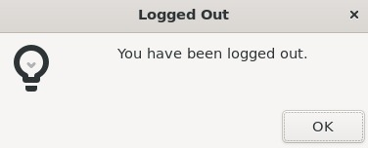

Slide 18
Conclusion
Summary:
The Library Management System simplifies book tracking and borrowing while offering a user-friendly interface.
UNIX provides a solid platform for such a command-line-based solution.
Future Enhancements:
Add support for more complex operations (e.g., overdue reminders, advanced search).
Improve security for login and registration processes.
Key Benefits:
Streamlines library management processes and makes them more efficient and error-free.

